Slide 1


The impact of winning funding on researcher productivity, results from a randomised trial
Presented by Prof Philip Clarke
Philip.clarke@ndph.ox.ac.uk
May 2025
Using lotteries in Australia to increase fairness and assess policy impacts when allocating scarce resources (Monday 12 May 2025, ANU, Canberra)

Slide 2
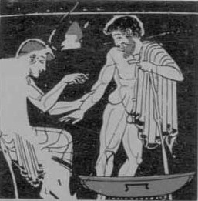
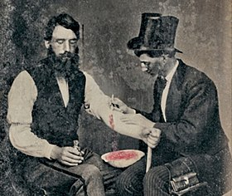
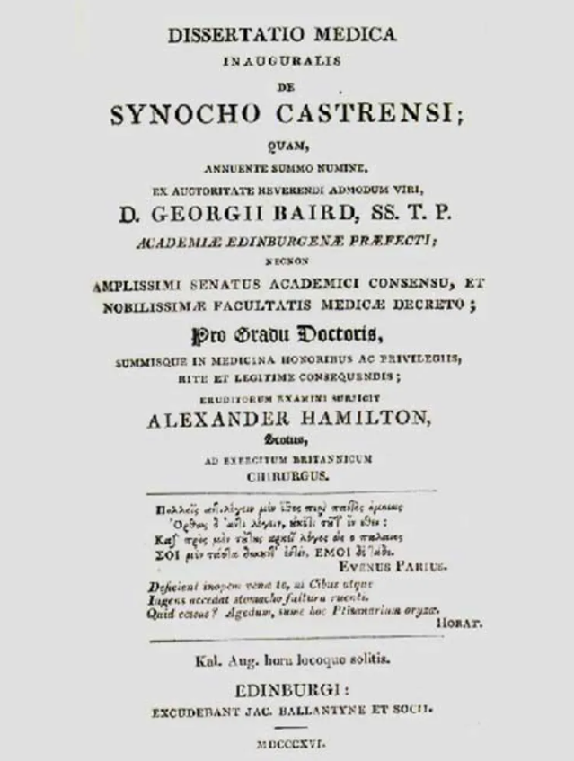
Randomized evidence…
“It had been so arranged, that this number was admitted, alternately, in such a manner that each of us had one third of the whole. The sick were indiscriminately received, and were attended as nearly as possible with the same care and accommodated with the same comforts….
He lost two, I four cases; whilst out of the other third [treated with bloodletting by the third surgeon] thirty five patients died.”
Lesassier Hamilton (1816)

Slide 3

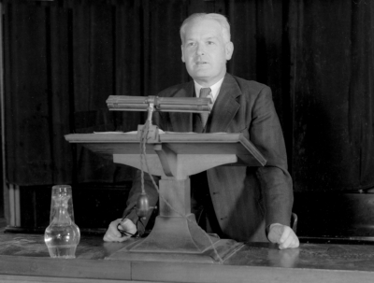
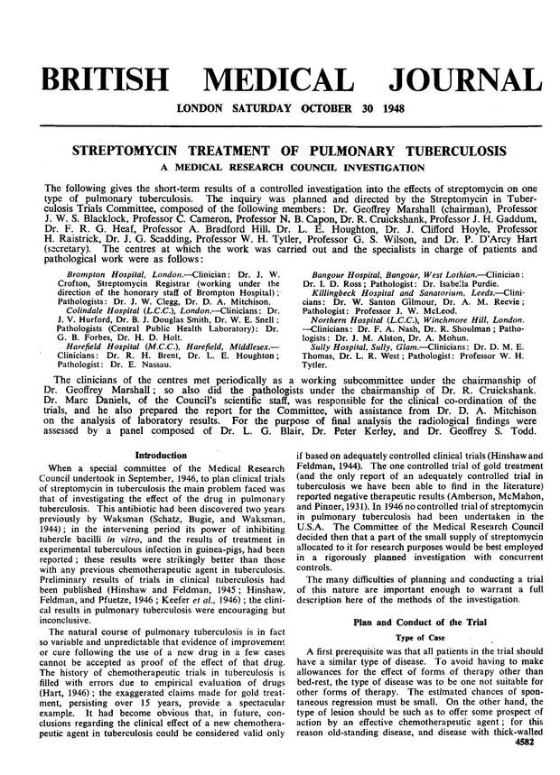
First modern medical randomized controlled trial
Given the uncertain prognosis of pulmonary tuberculosis and the limited supply of the drug, Bradford Hill proposed that it would be unethical not to assess what advantage streptomycin offered in this form of the disease compared with the current standard treatment—bed rest.”
At six month 15 of 52 patients allocated to bed rest vs 5 in 55 patient receiving streptomycin
“Neither group of patients knew that they were in a trial, which remained confidential throughout its 15 month duration.”

Slide 4
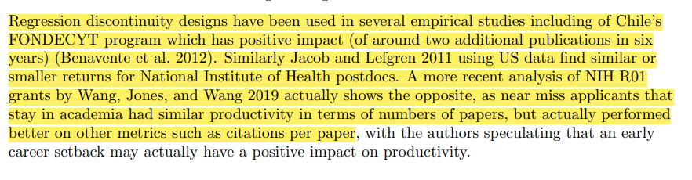
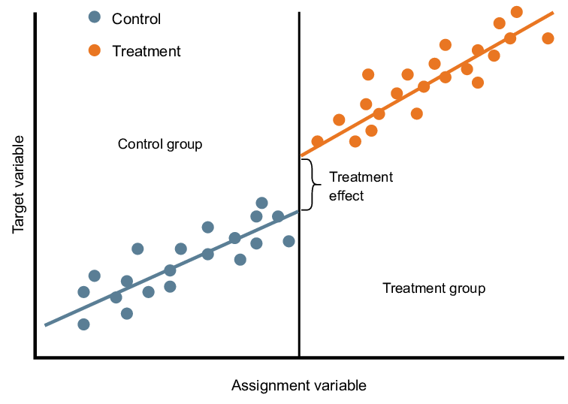
Alternatives to randomisation…

Slide 5
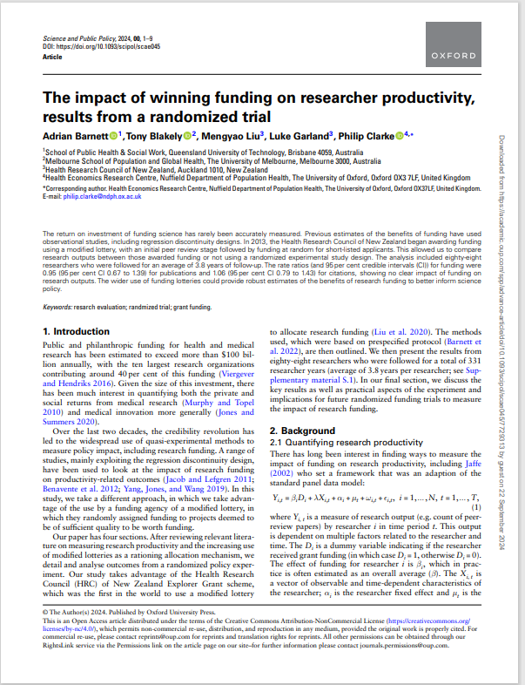
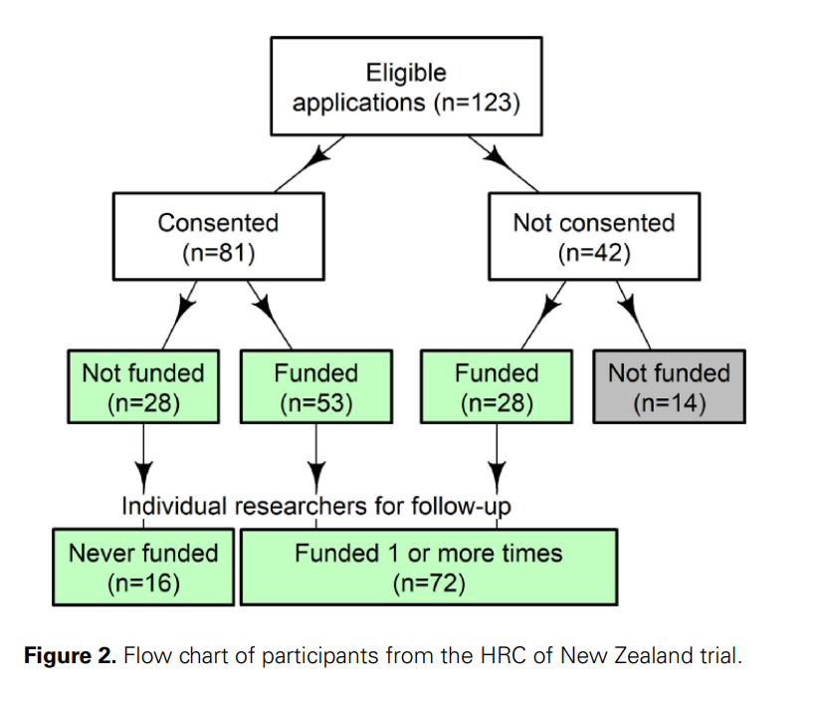
More on the experiment
81 (of 123 applicants have consented) and 204 years
The pre-defined outcome is number of publications, many secondary outcomes
After 7 years we have about the same statistical power as Bradford-Hill had for his RCT of streptomycin

Slide 6
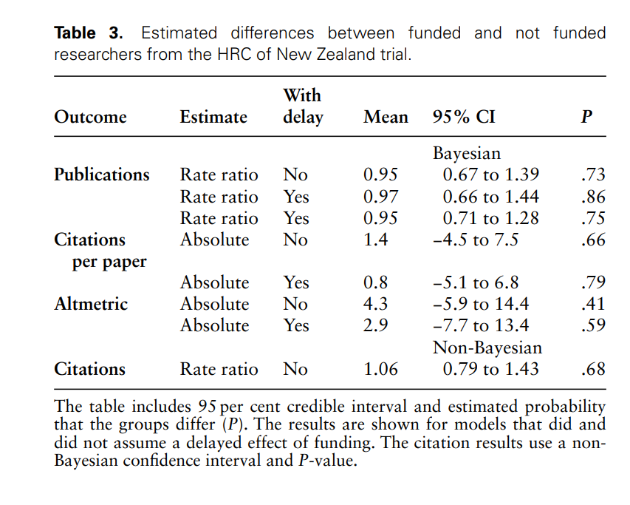
Results… more randomised funding needed!

Slide 7
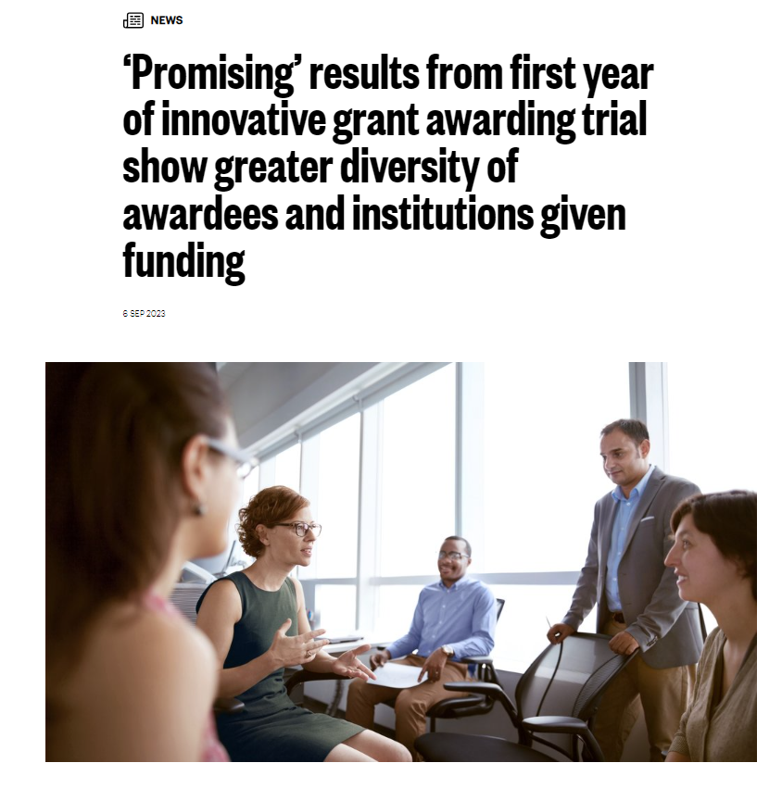
Now working with the British Academy …
Have worked with the British Academy (BA), which now randomly allocates hundreds of small (£10K) grants via a conditional lottery;
We will, for the first time, have a large RCT of research funding (3000+ randomised) ;
Now, working with the BA to define relevant outcomes for the experiment that align with the aims of the scheme.
One of the benefits is that it makes funders define what they re wanting to acheive

